Slide 1
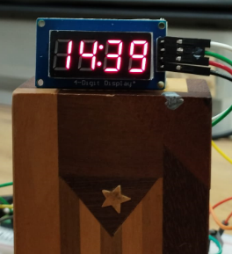
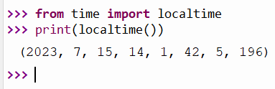
Turning the 7 Segment Display into a digital clock
Python has a library called time
We have used the sleep module from time
Remember this:
from time import sleep
sleep(5) - gives us a 5 seconds delay
time has another module/function called localtime
from time import localtime
localtime() gives us the current date time information
It is organized as a tuple.
A tuple is a collection of data, separated by comma inside 2 round brackets
(Y, M, D, H, M, S, Day of Week, No of days from Jan 1)

Slide 2

Turning the 7 Segment Display into a digital clock
localtime()
0
1
2
3
4
5
6
7
We can assign it to a variable called timenow
timenow=localtime()
year = timenow[0]
print(year)
Result: 2023
hr=timenow[3]
print(hr)
Result : 14
Each data in the tuple has an index number
by which it can be addressed
Can you get the minute?

Slide 3
Once you know how to get the hr and min from localtime()
you can send the hr and min data to the 7 segment display
To show the hr and min on the 7 segment display:
tm.number(hr,min)
This is Ex 2.
Complete the following, to turn the display into a digital clock
You only need to refresh the display only after 1 minute as this
digital clock do not show time in seconds. You need sleep(??)
import tm1637
from machine import Pin
from time import sleep, localtime
tm = tm1637.TM1637(clk=Pin(5), dio=Pin(4))
tm.show(" ") #to blank out the display
while True:
………………………
………………………
………………………
Please give Ex2 your best shot.
Send me your surrender emoji and
I will dispatch the answer to you.

Slide 4
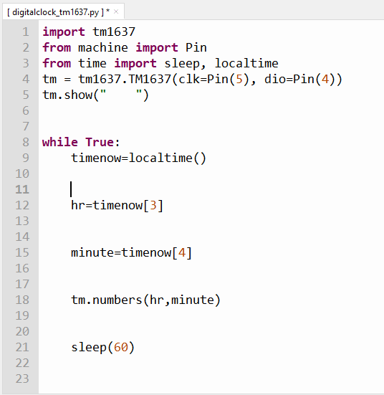
INTRODUCING PYTHON TUPLE
Solution to Ex 2
localtime() gives us the date/time information in this format
Here we are giving this info a name called timenow
timenow becomes a snap shot of this time
10
22
10
22
We have space on the 7 segment display for hh and mm only, so we need only to refresh
the display every minute (60 seconds)

